Slide 1
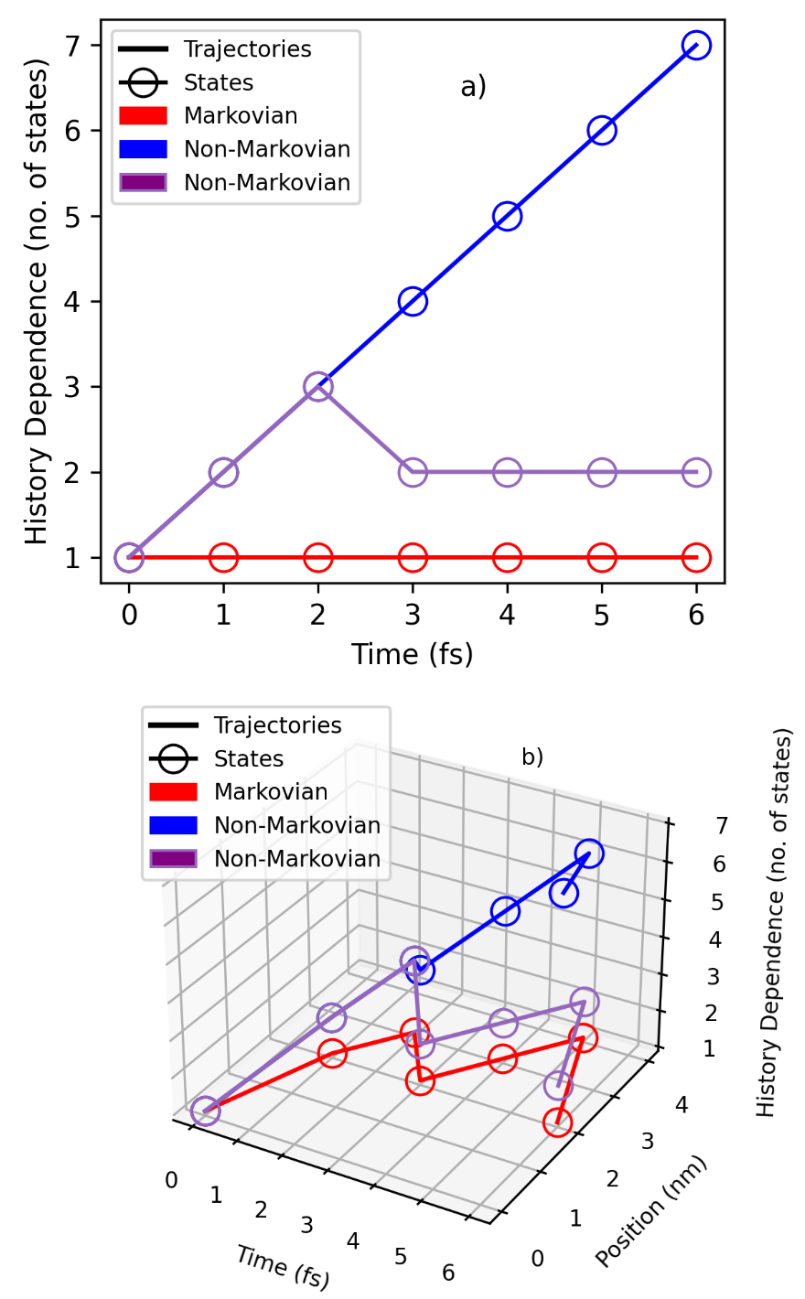

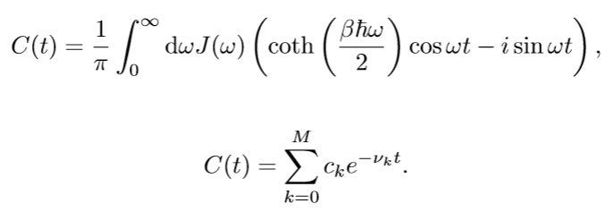
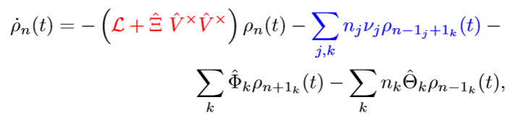
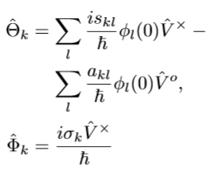
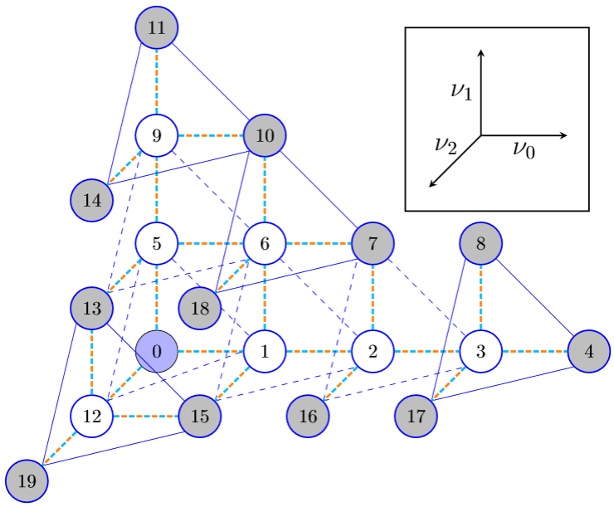
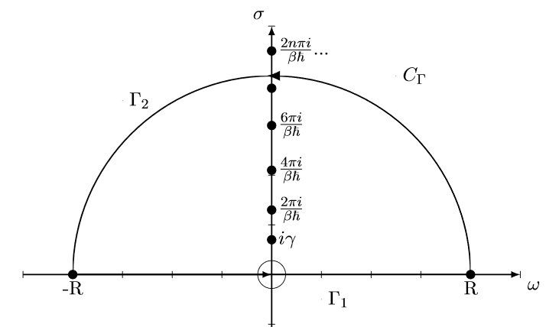
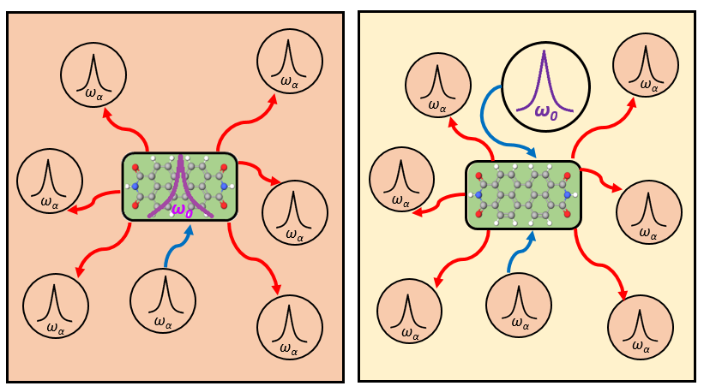
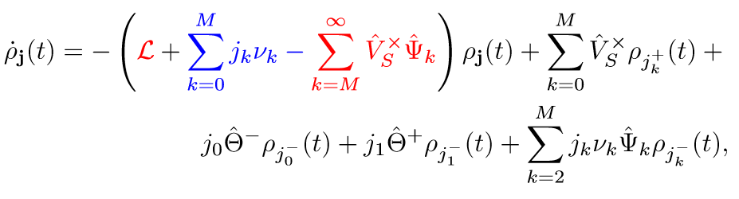
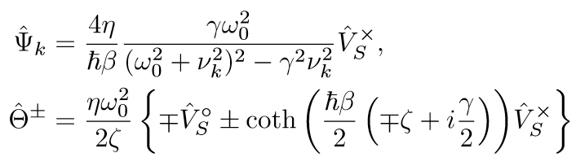
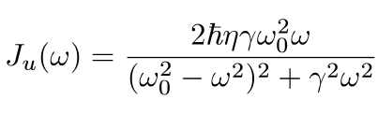
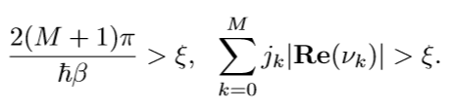
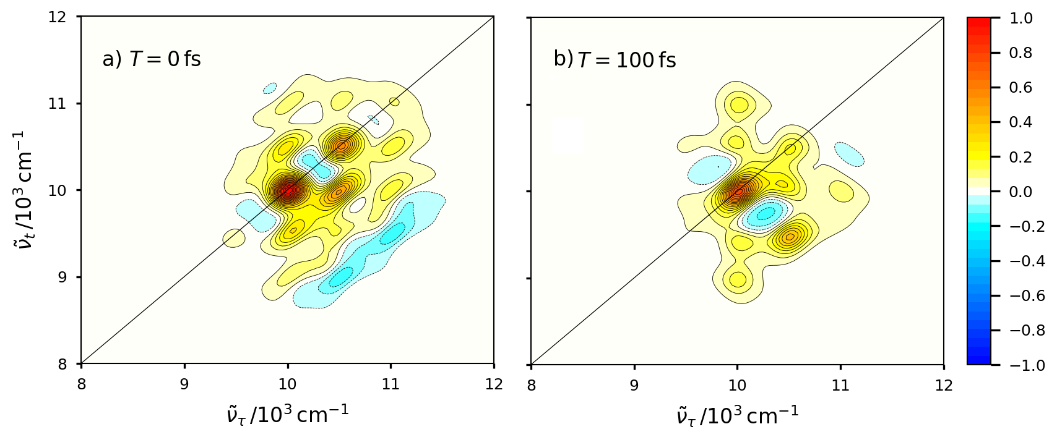
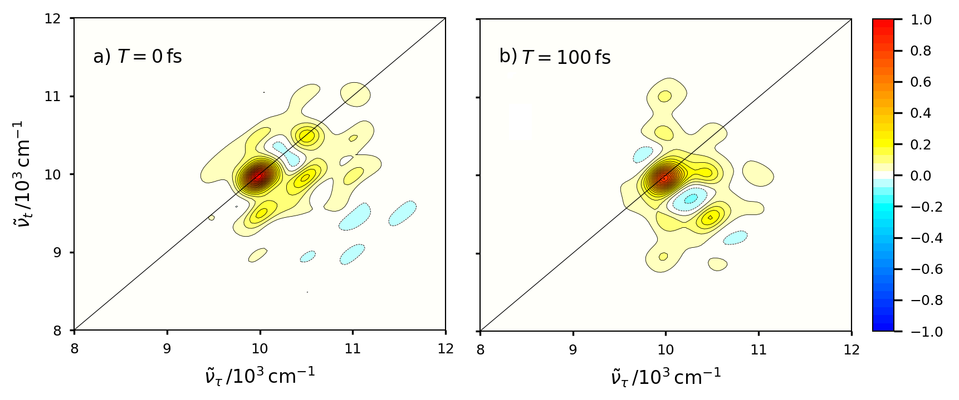
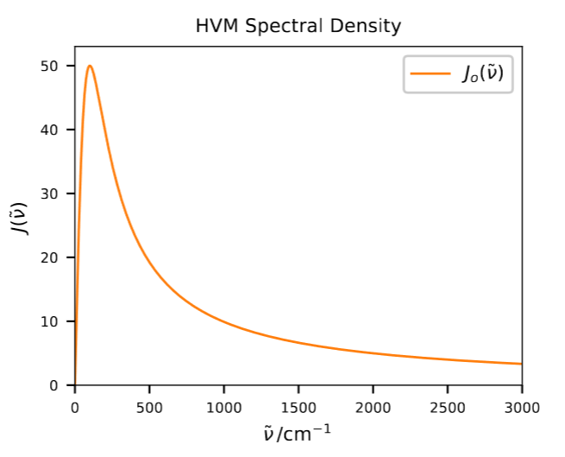
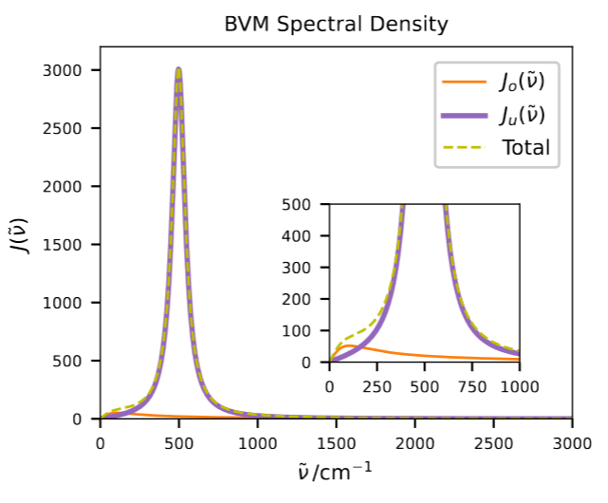
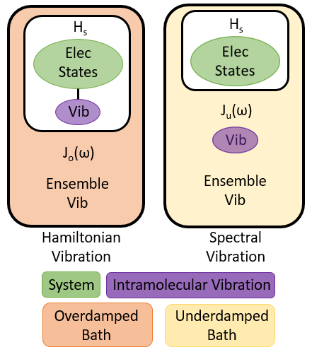
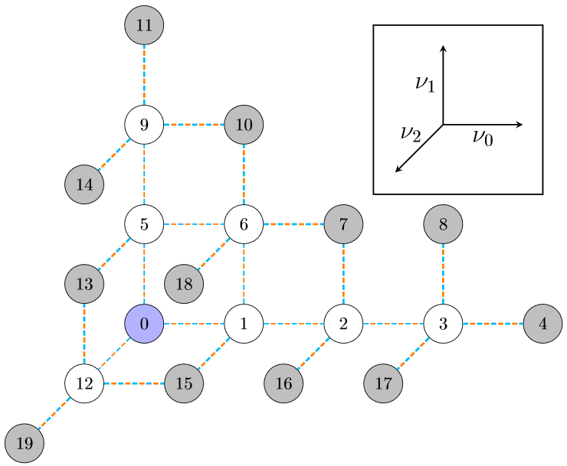
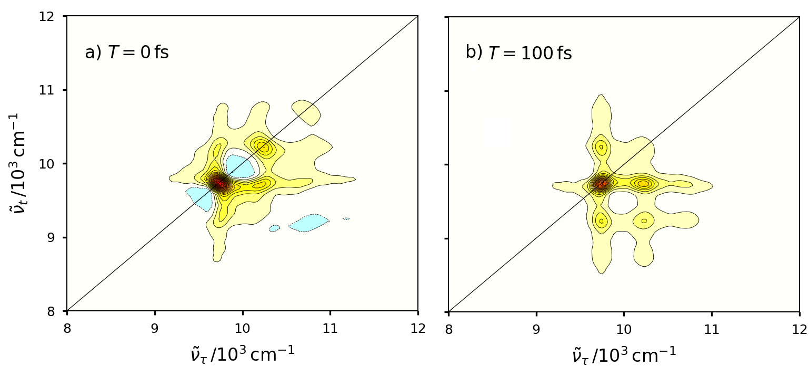
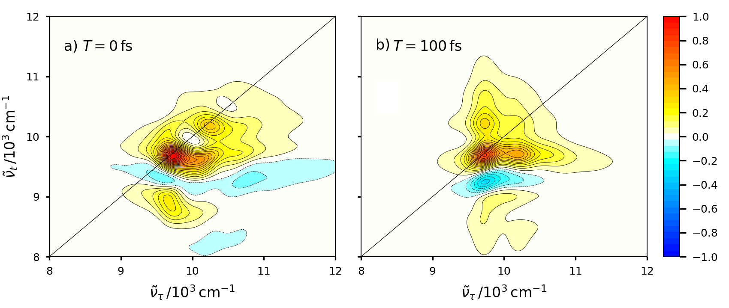
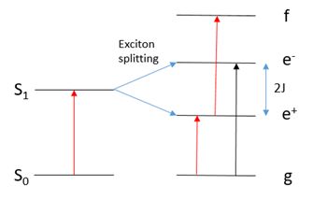
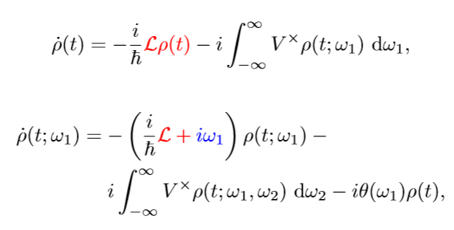
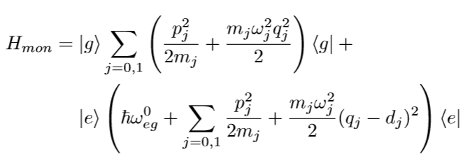
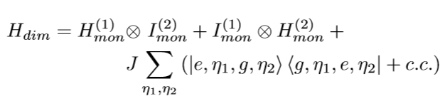
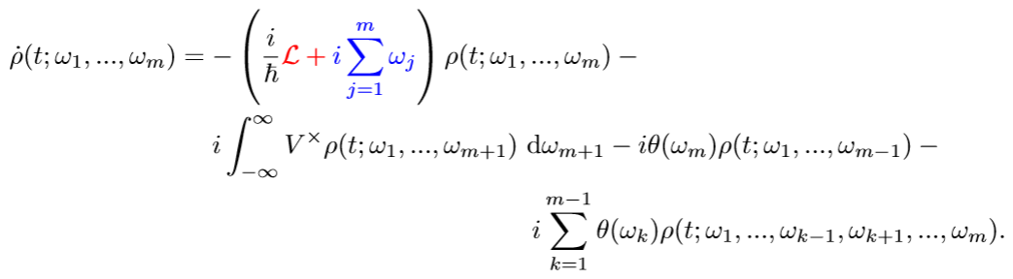
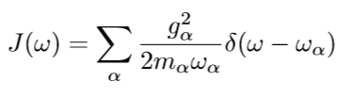
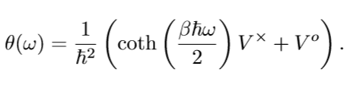
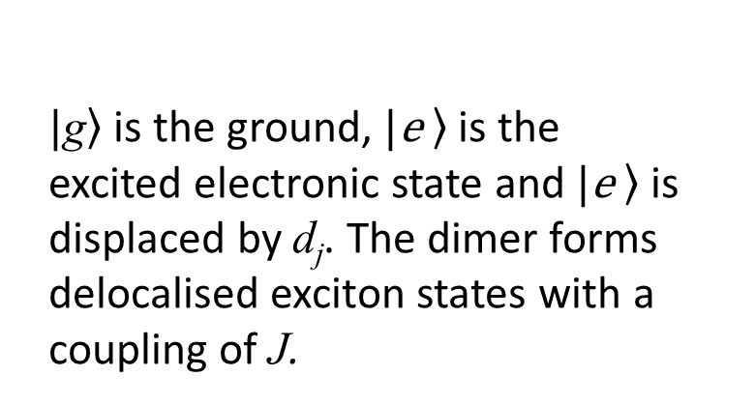
Non-Markovian hierarchical equation of motion approaches to modelling open quantum systems
Ben S. Humphries,ª Dale Green,ª and Garth A. Jonesª
School of Chemistry, University of East Anglia, Norwich Research Park, Norwich, NR4 7TJ, UK
Email: b.humphries@uea.ac.uk
Non-Markovianity
Generalised Hierarchical Equations of Motion
Fig 3: Depicting Markovianity. 3 a) shows state history dependence in 2D. Markovian cases are 1D lines because there is no gradient which is equivalent to zero information flux.
3 b) repeats 3 a) but with explicit positional variation within the state trajectory.
Through application of the cumulant expansion⁵ rather than the path integral formalism, the HEOM can be derived in a new basis. Traditional HEOMs are dependent on linear combinations of exponentials in the correlation function due to the complex contour integral used to calculate them but the generalised HEOM avoids this. The non-Markovian system-bath interaction operator, θ, becomes dependent on the matsubara frequency.
This increases the power of the HEOM as it can now model a full range of homogeneities, including critical damping.
The graphs in fig 3 directly link to the ADO hierarchy diagrams in figs 4 and 5, because any of the lines in fig 3 with gradient can be considered dependent on the coupling operator V^{X} . This implies a relationship between information flow and the orange and cyan couplings
HEOM:
Introduction
Hierarchical equations of motion approaches non-perturbatively couple open quantum systems (OQS) directly to an harmonic environment. The harmonic environment, usually expressed as stochastic bath modes, has the potential to express bath-bath interactions, bath-system interactions, and intramolecular vibrations. Additionally, the hierarchical structure of the auxiliary density operators (ADOs) makes it possible to derive equations with different correlation function bases . Here, we demonstrate that the coupled, hierarchical structure of the HEOM can give rise to complex vibronic structure in 2D electronic spectra (2DES) when applied to dimer systems, and consider the power of a range of hierarchical models.
Hierarchical Equations of Motion
Using an underdamped spectral density, J_{u}(ω), it is possible to derive² an hierarchy of equations of motion which can account for non-Markovian memory effects in the OQS. The hierarchy of ADOs has significant power over the dynamics: red terms represent Markovian dynamics of the free propagation of the system, blue terms describe non-Markovian free propagation of the bath, and the black terms are system-bath interactions. The cyan and orange highlighted terms behave similar to ‘raising’ and ‘lowering’ between higher and lower ADOs respectively.
Hamiltonian Vibration model, and Spectral Vibration Model
Fig 1: Diagram depicting a perylene bisimide monomer interacting with a bath. In the first case the bath is purely overdamped, the second case shows the increased complexity of the underdamped bath and its components. The red and blue arrows depict Markovian and non-Markovian information flow respectively. This information flow is the flux mentioned in figure 3. Continuous spectral densities for the ensembles are shown below each environment box.
Fig 5: An hierarchy diagram for the HEOM showing pyramidal structure of connections between ADOs. Cyan ‘relaxation’ terms move towards the density matrix, orange ‘excitation’ terms move away. Blue lines go in both directions. Blue nodes self interact, the density matrix is the only non self-interacting node.
Fig 6: A complex contour in frequency space used to solve the correlation function. Residues of the poles correspond to Matsubara frequencies, relating to system energies.
2DES Bath Vibration Model and Hamiltonian Vibration Model
Termination³ upon reaching convergence parameter, ξ, at assumed Markovian limit
Fig 4: An hierarchy diagram for the HEOM showing connections between ADOs. Grey nodes are termination ADOs, cyan lines move towards the density matrix, orange move away and correspond to the terms of the same colour
Fig 2: A generalised depiction of Hamiltonian Vibration and Spectral (Bath) Vibration models of an OQS. The intramolecular vibration of interest is either coupled to the Hamiltonian electronic states, or subsumed within an underdamped bath.
2DES Hamiltonian Vibration Mdel
Arbitrary Spectral Density Hierarchical Equations of Motion (ASD-HEOM)
Fig 7: The purple box contains spectra for the underdamped and overdamped monomer, the green box contains the HVM and BVM for the weak dimer. These results highlight that the BVM can reproduce vibronic behaviour demonstrated in the Hamiltonian approach.
Open Quantum Systems
The Hamiltonian for an OQS is split into the system (solute) and the environment, or bath (solvent). The system of interest or the solute is, in its most general form, a tensor product of the electronic and vibrational degrees of freedom. For our dimer example:
Following a derivation⁴ equivalent to that which is used for the standard underdamped HEOM, it is possible to create the ASD-HEOM when the spectral density is kept general. By using J(ω) the influence functional in Fourier form is simplified, however subsequent differentiation to an equation of motion yields integrals over Matsubara frequencies.
Summary and Future Research
Future research will involve extending codes for the HEOM so that fully arbitrary spectral densities and correlation functions may be applied.
Arbitrary spectral density and correlation function
Further hierarchical equation derivations in non-exponential bases
The spectral power of the HEOM in reproducing vibronic structure has been emphasised. Additional derivations, the ASD-HEOM and generalised HEOM, resulting in an extra degree of freedom over the spectral density or correlation function have been outlined. Terms in each approach have been analysed and ADO structure considered.
The bath is defined¹ as a linear combination of delta functions corresponding to an ensemble of environment modes. The profile is taken as a continuous spectral density function.
Term colours are equivalent to the previous equations so that they can be compared. The integrals behave similarly to a phonon creation term but are not explicitly equivalent to cyan
$\left.|\text{g}\right\rangle$is the ground, $\left.|\text{e} \right\rangle$ is the excited electronic state and $\left.|\text{e} \right\rangle$is displaced by d_{j}. The dimer forms delocalised exciton states with a coupling of J.
References
D. Green, B. S. Humphries, A. G. Dijkstra, and G. A. Jones, Journal of Chemical Physics151, 1 (2019).
Y. Tanimura and R. Kubo, Journal of the Physical Society of Japan58, 101 (1989).
A. G. Dijkstra and V. I. Prokhorenko, Journal of Chemical Physics 147, 1 (2017)
Y. Tanimura, Physical Review A41, 6676 (1990).
T. Ikeda and G. D. Scholes, The Journal of chemical physics152, 204 101 (2020), arXiv:2003.06134.
Y. Fujihashi, G. R. Fleming, and A. Ishizaki, Journal of Chemical _ _ _ Physics 142 (2015), 10.1063/1.4914302, arXiv:1505.05281.

